Slide 1

Cross-Platform Texting App

Slide 2
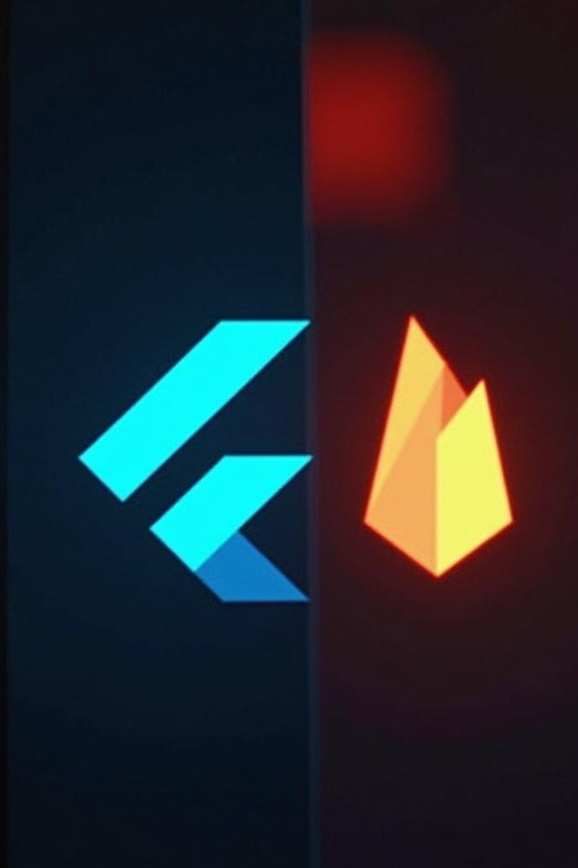
Introduction
This presentation outlines the features and functionality of a cross-platform chat application built with Flutter and Firebase. It highlights key components such as user authentication, real-time messaging capabilities, and a unique priority-setting feature aimed at enhancing user experience and communication.

Slide 3

01
Project Overview

Slide 4
Description of the Chat App
The chat application is designed to facilitate real-time communication across multiple platforms, including Android, iOS, and web. It integrates Firebase for backend services, ensuring secure authentication and reliable data storage. The app is tailored for both casual and professional use, enhancing productivity through efficient messaging.

Slide 5

Platforms Supported
This application is scaffolded for a wide range of platforms, including Android, iOS, web, Windows, macOS, and Linux. It leverages Flutter's capabilities to maintain a consistent user interface and experience across devices, thereby increasing its accessibility and user reach.

Slide 6

Use Case Scenarios
The chat application is ideal for various scenarios, including workplace communication, team collaboration, and emergency response coordination. With its secure authentication and real-time messaging capabilities, users can efficiently log in, send, and receive messages. The priority-setting feature allows users to triage messages effectively, ensuring timely responses and improved issue escalation.

Slide 7
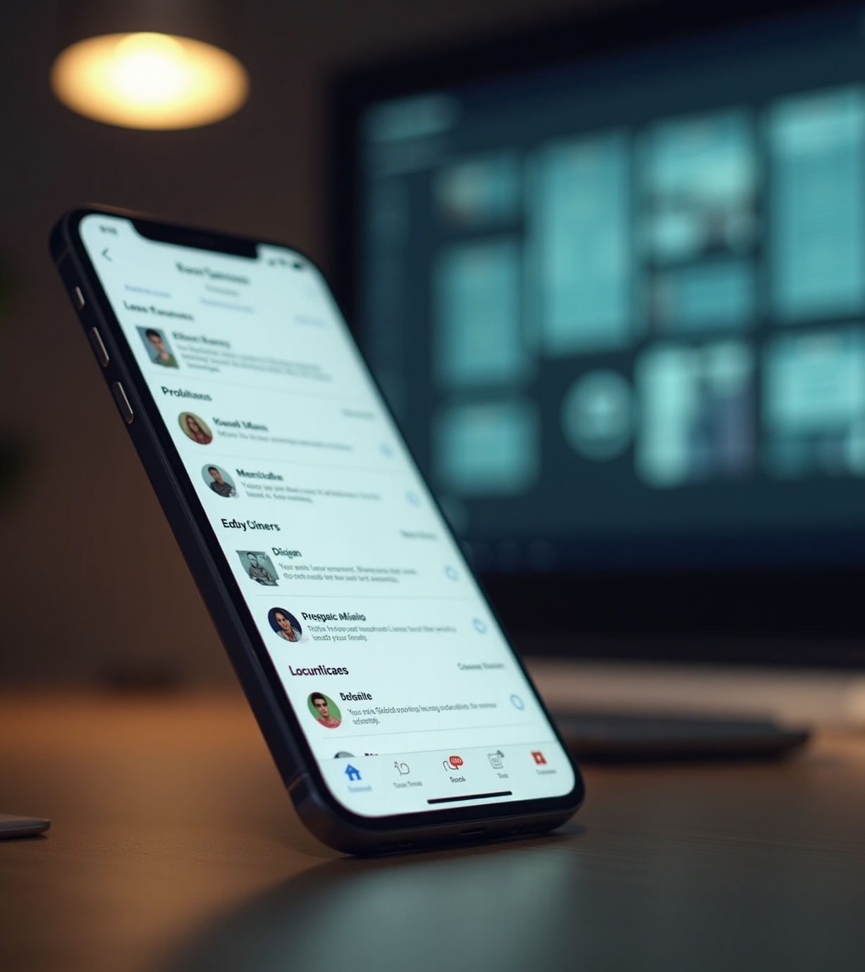
Key Features
02

Slide 8

Authentication Mechanism
The app employs Firebase Authentication, providing a secure and streamlined process for user login and registration. This mechanism ensures that user credentials are protected while facilitating easy access to the chat functionality. By leveraging industry-standard authentication protocols, the app aims to maintain high security and user trust.

Slide 9

Chat Functionality
The chat functionality is designed for real-time communication, leveraging Firebase for reliable message handling. Users can enjoy seamless conversations with a user-friendly interface that supports various chat features. The application updates messages instantly, making it an efficient tool for ongoing discussions, whether in personal or professional contexts.

Slide 10
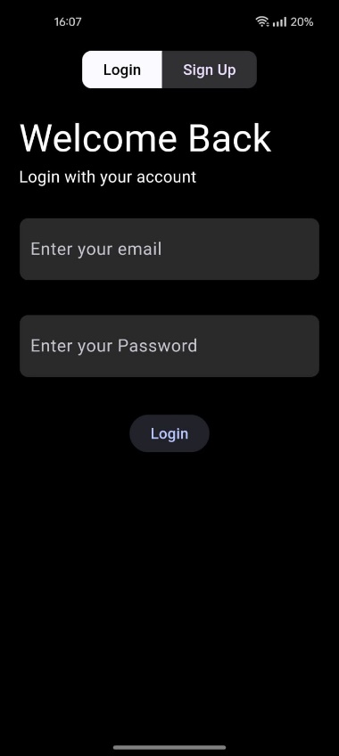
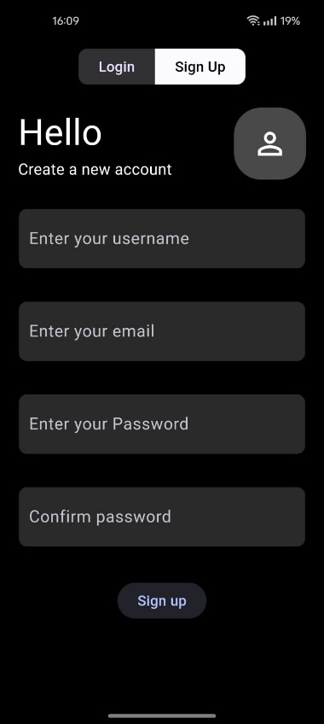
WORKING OF THE APP
1) Login page:

Slide 11
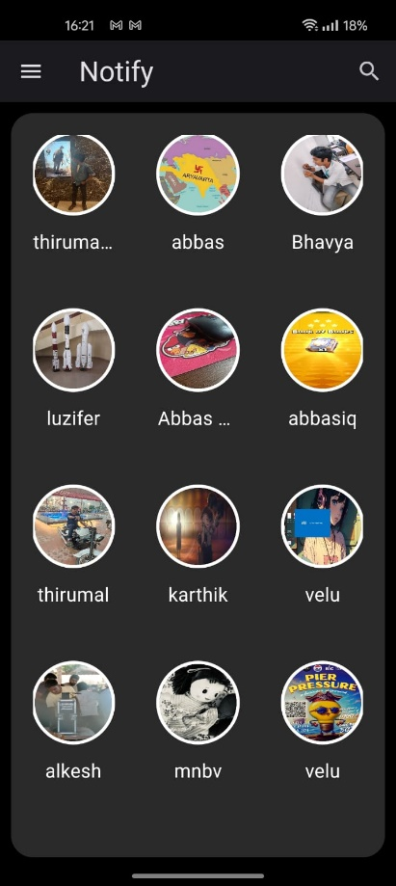
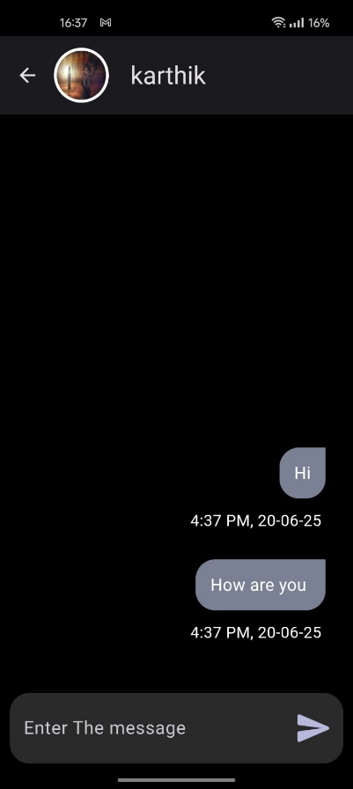
2) Home page:
3) Texting:

Slide 12
THANK YOU
Worked upon by :
R.Sashi Bhushan 22BAI1293
Lokesh chakka 22BPS1135

